Slide 1

COST Unit 4
Small Sampling Theory

Slide 2

F distribution
Called as Fisher’s F Distribution.
z score, or z statistic is replaced by a suitable F score, or F statistic.
$$F=\frac{\frac{N_{1}S_{1}^{2}}{(N_{1}−1)σ_{1}^{2}}}{\frac{N_{2}S_{2}^{2}}{(N_{2}−1)σ_{2}^{2}}}$$
Where,
$N_{1}$= Sample 1 size
$N_{2}$= Sample 2 size
$σ_{1}$ = Population 1 SD
$σ_{2}$= Population 2 SD
$S_{1}$= Sample 1 SD
$S_{2}$= $Sample 2 SD$

Slide 3
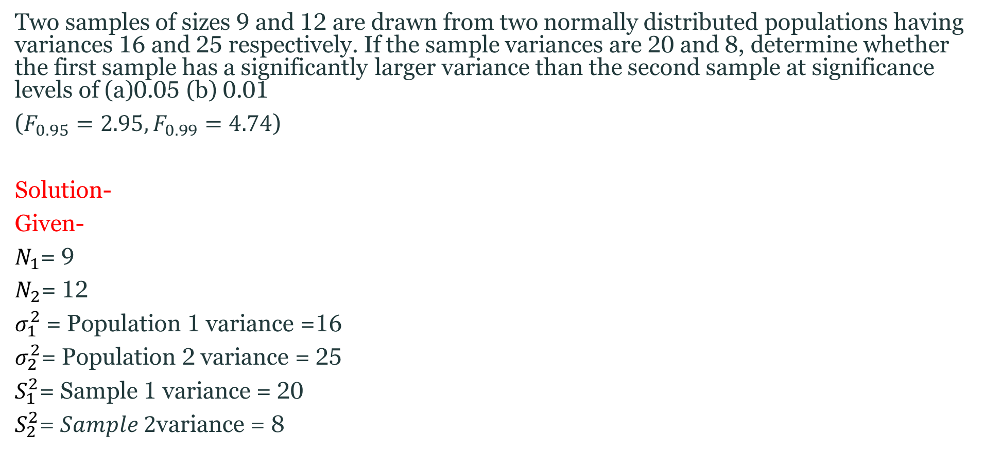
Question
Two samples of sizes 9 and 12 are drawn from two normally distributed populations having variances 16 and 25 respectively. If the sample variances are 20 and 8, determine whether the first sample has a significantly larger variance than the second sample at significance levels of (a)0.05 (b) 0.01
($F_{0.95}=2.95, F_{0.99}=4.74$)
Solution-
Given-
$N_{1}$= 9
$N_{2}$= 12
$σ_{1}^{2}$= Population 1 variance =16
$σ_{2}^{2}$= Population 2 variance = 25
$S_{1}^{2}$= Sample 1 variance = 20
$S_{2}^{2}$= $Sample 2\text{variance}$= 8

Slide 4

Cont..
Formula-
$F=\frac{\frac{N_{1}S_{1}^{2}}{(N_{1}−1)σ_{1}^{2}}}{\frac{N_{2}S_{2}^{2}}{(N_{2}−1)σ_{2}^{2}}}$
$$F=\frac{(9)(20)/(9−1)(16)}{\begin{aligned}(12)(8)/(12−1)(25) \\ \end{aligned}}$$
F = 4.03

Slide 5
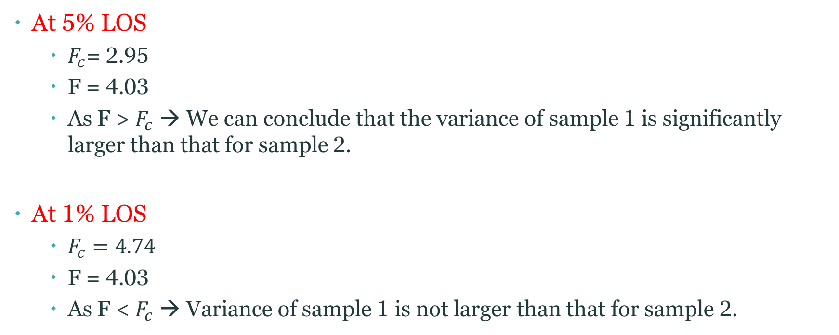
Cont..
At 5% LOS
$F_{c}$= 2.95
F = 4.03
As F > $F_{c}$ → We can conclude that the variance of sample 1 is significantly larger than that for sample 2.
At 1% LOS
$F_{c}=4.74$
F = 4.03
As F < $F_{c}$ → Variance of sample 1 is not larger than that for sample 2.

Slide 6
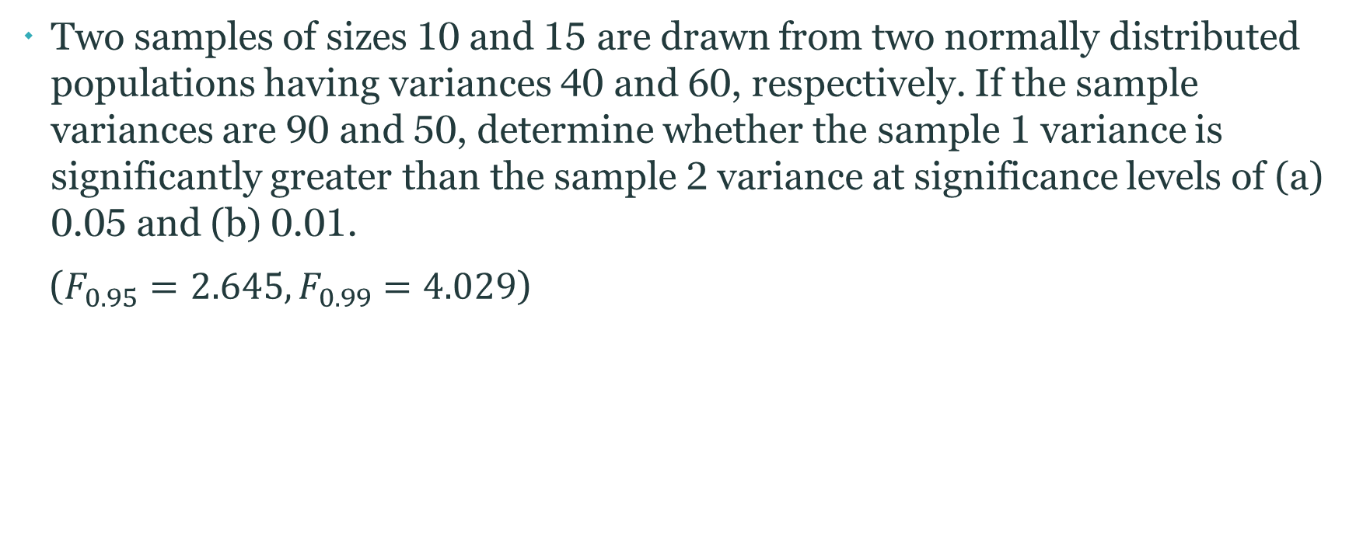
Question
Two samples of sizes 10 and 15 are drawn from two normally distributed populations having variances 40 and 60, respectively. If the sample variances are 90 and 50, determine whether the sample 1 variance is significantly greater than the sample 2 variance at significance levels of (a) 0.05 and (b) 0.01.
($F_{0.95}=2.645, F_{0.99}=4.029$)

Slide 7
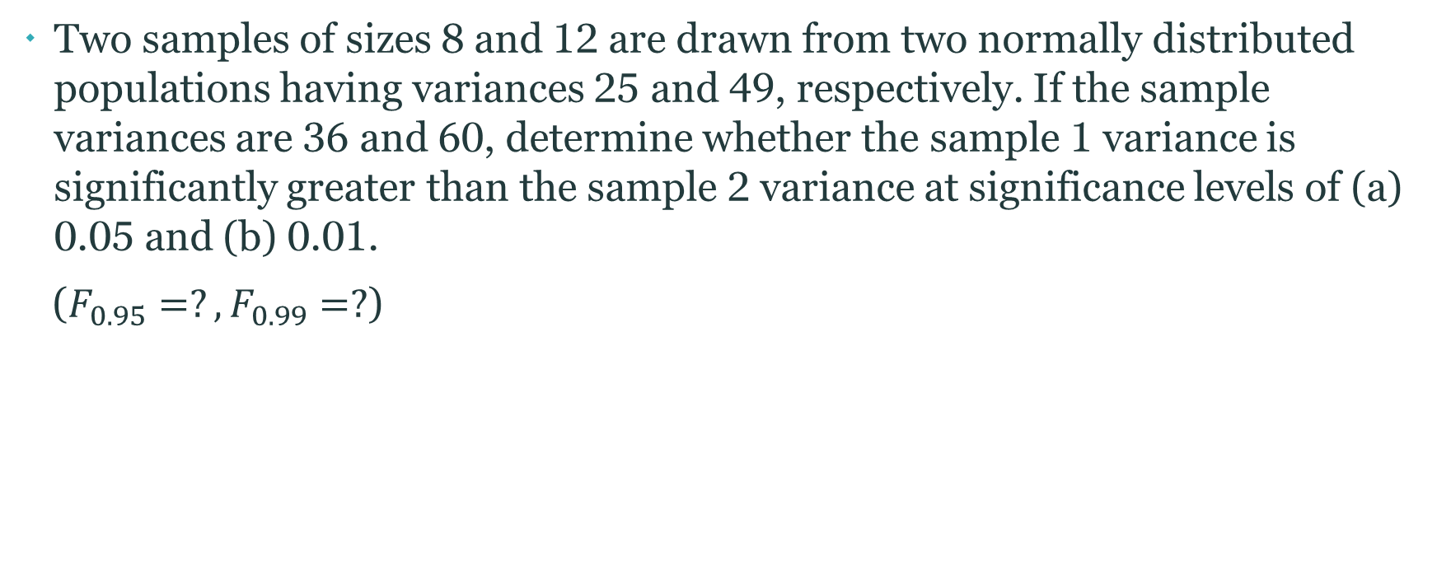
Question
Two samples of sizes 8 and 12 are drawn from two normally distributed populations having variances 25 and 49, respectively. If the sample variances are 36 and 60, determine whether the sample 1 variance is significantly greater than the sample 2 variance at significance levels of (a) 0.05 and (b) 0.01.
($F_{0.95}=?, F_{0.99}=?$)

